Slide 1
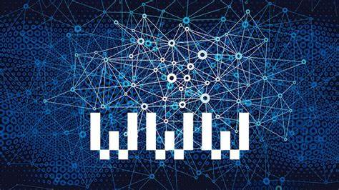
How does the web work !

Slide 2
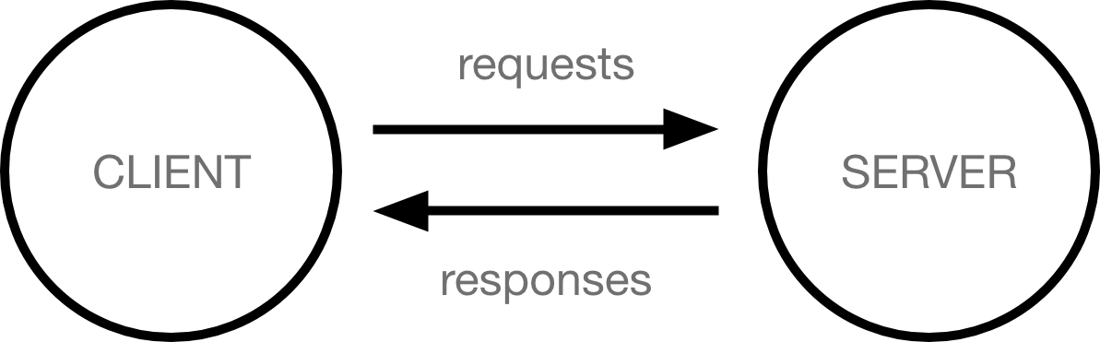
How does the web work ?
How the web works provides a simplified view of what happens when you view a webpage in a web browser on your computer or phone.
This theory is not essential to writing web code in the short term, but before long you'll really start to benefit from understanding what's happening in the background .
Computers connected to the internet are called clients and servers. A simplified diagram of how they interact might look like this:
Clients are the typical web user's internet-connected devices (for example, your computer connected to your Wi-Fi, or your phone connected to your mobile network) and web-accessing software available on those devices (usually a web browser like Firefox or Chrome).
Servers are computers that store webpages, sites, or apps. When a client device wants to access a webpage, a copy of the webpage is downloaded from the server onto the client machine to be displayed in the user's web browser.

Slide 3
Defining parts of the web
Client: An application, such as Chrome or Firefox, that runs on a computer and is connected to the internet. Its primary role is to take user interactions and translate them into requests to another computer called a web server. Although we typically use a browser to access the web, you can think of your whole computer as the “Client” piece of the client-server model. Every client computer has a unique address called an IP address that other computers can use to identify it.
Server: A machine that is connected to the internet and also has an IP address. A server waits for requests from other machines (e.g. a client) and responds to them. Unlike your computer (i.e. the client) which also has an IP address, the server has special server software installed and running which tells it how to respond to incoming requests from your browser. The primary function of a web server is to store, process and deliver web pages to clients. There are many types of servers, including web servers, database servers, file servers, application servers, and more. (In this post, we’re talking about web servers.)
IP address: Internet Protocol Address. A numerical identifier for a device (computer, server, printer, router, etc.) on a TCP/IP network. Every computer on the internet has an IP address that it uses to identify and communicate with other computers. IP addresses have four sets of numbers separated by decimal points (e.g. 244.155.65.2). This is called the “logical address”. In order to locate a device in the network, the logical IP address is converted to a physical address by the TCP/IP protocol software. This physical address (i.e. MAC address) is built into your hardware.
ISP: Internet Service Provider. ISP is the middle man between the client and servers. For the typical homeowner, the ISP is usually a “cable company.” When your browser gets a request from you to go to www.github.com, it doesn’t know where to look for www.github.com. So it’s the ISP’s job to do a DNS (Domain Name System) lookup to ask what IP address the site you’re trying to visit is configured to.
DNS: Domain Name System. A distributed database which keeps track of computer’s domain names and their corresponding IP addresses on the Internet. Don’t worry about how a “distributed database” works for now: just know that DNS exists so users can enter www.github.com instead of an IP address.
Domain Name: Used to identify one or more IP addresses. Users use the domain name (e.g. www.github.com) to get to a website on the internet. When you type the domain name into your browser, the DNS uses it to look up the corresponding IP address for that given website.

Slide 4


What do you need to be a web developer?

Slide 5
Skills that can almost guarantee your jobs and opportunities for years and decades to come.
One of these skills is web development.
Have you been wondering how to become a web developer?
Contrary to a popular belief, you don’t need a fancy bachelor’s degree in computer science to become a web developer and create a functional website.
In fact, if you follow the instructions in this article, you can become a web developer a lot quicker than you think (but it will still take some hard work!).
Ready? Let’s start with the basics:
What/Who is a Web Developer
Here’s the simple answer to this question: They build and maintain websites.
In other words – they literally create how you experience the web. The websites which want users to enjoy their experience need great web developers – and they’re usually willing to fork over some serious cash to get these great web developers.
Responsibilities of a web developer:
Write web pages with a combination of markup languages.
Create quality mockups and prototypes.
Build a WordPress site from scratch.
Understand HTML and CMS.
Understand UI, UX and learning usability.
Develop functional and appealing websites and web-based applications.
Provide website maintenance and enhancements.
These are the most common requirements, but your responsibilities and tasks will vary depending on the web development gig as well as your web development specialty.
Speaking of web development specialties, there are three that you should be aware of:
Frontend development: The “frontend” refers to “stuff” on a website that you see and interact with, e.g. menus, dropdowns, etc.
Backend development: The “backend” is like the portion of the iceberg below the surface. Without it, the website can’t function. The backend deals with servers, applications, databases, etc.
Full-stack development: This is the combination of both backend and frontend development.

Slide 6
Why did you choose to learn web development?
Web developers love solving problems
Web development is a fast-paced, challenging career centered on creative problem-solving and continuous innovation.
As a web developer you’ll work with a multidisciplinary team of designers, other developers, and marketers to realize your projects.

